Slide 1

SMART ENERGY METER
Index
1
Project Details/Problem Statement
2
Concept of the Solution
3
Novelty / Scope of Solution
4
Pros and Cons of the solution
5
Technical Description
6
Implementation Plan or Working Model (as the case may be)
7
Validation/Testing/Analysis
8
Cost Estimate (If needed)
9
References

Slide 2
Problem Statement
Energy saving is the most important and challenging issue. Smart power meter is used in domestic electric power distribution system. The integration of the Node-MCU,PZEM sensor, Relay and provides the system as Smart Power Monitoring system. Smart power meter provides data for optimization and reduce the power consumption. This product can be used in natural resources and can foster economic and social development. This system communicates with embedded controller and ESP8266 module to transmit the data. Domestic consumers get benefited through this system

Slide 3
Concept of the solution
Brief about the concept of your solution
Electricity has become the basic requirement for humans
Conserving electricity is as much as important as saving water
IOT based smart systems can overcome wastage of electricity.
The objective of our proposed system is to monitor and conserve electricity.

Slide 4
Novelty / Scope of Solution
What is novel in your mentioned idea and scope of the proposed solution
Similar projects like this usually use internet connection for transmission of data.
The main advantage of our project is that we can see the data from the sensor without the use of internet connection. The budget is also low compared to other existing models.
The usage of Node-MCU allows us to operate the Power meter even without the use of internet. Node-MCU connects through the local network which includes a Wi-Fi modem, mobile phone

Slide 5
Pros and Cons of the solution
What is novel in your mentioned idea and scope of the proposed solution
The main scope of this project is to develop,
cost affordable
energy conserving
user friendly interface.

Slide 6
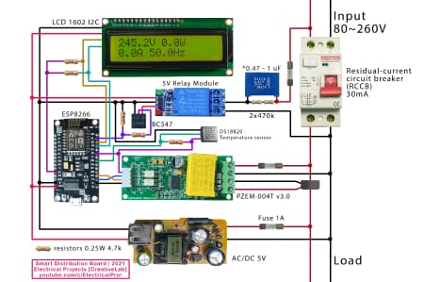
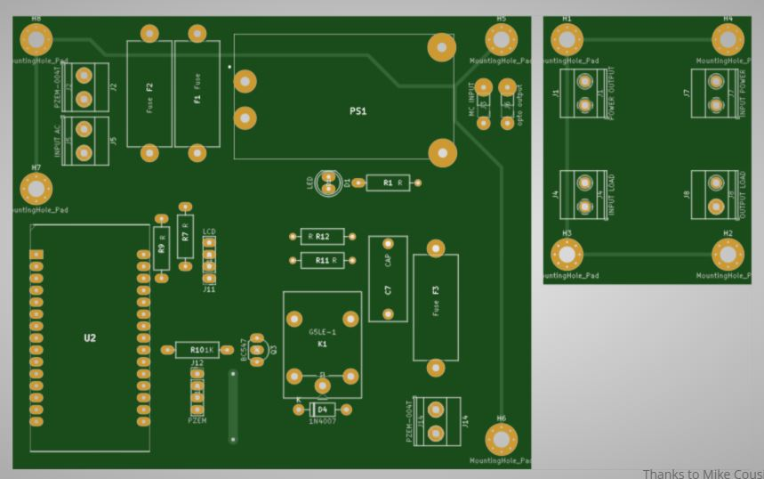
Technical Description
Model of Prototype PCB Layout

Slide 7
Implementation Plan/Working Model
NodeMCU is an open source IoT platform based on ESP8266 which can connect objects and let data transfer using the Wi-Fi protocol. PZEM-004T is an electronic module that functions to measure: Voltage, Current, Power, Frequency, Energy and Power Factors. The Node-MCU is connected to PZEM sensor which calculates the units of power used and Relay controls the MCB. We set the limit of power consumed and if it reached the limit the relays turns on and switches the MCB off to stop the power supply. Relay will turn the MCB off when it detects that the supply and return current are not balanced.
The load wire is inserted inside the PZEM sensor which calculates the power used displays it in LCD. We can see the power consumed by using the HTML page, by copying the IP address and pasting it in the chrome browser. A static IP address is created for this. It displays the power consumed, current, and voltage etc., used. By using the mobile phone we can see the amount of power consumed in our home or work place and conserve the electricity accordingly.

Slide 8
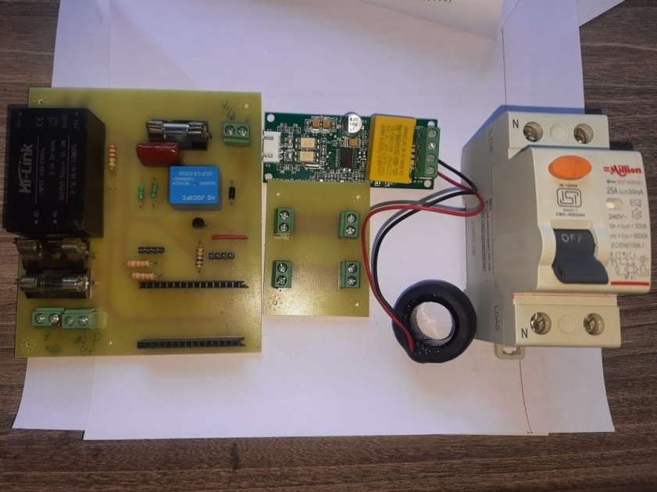
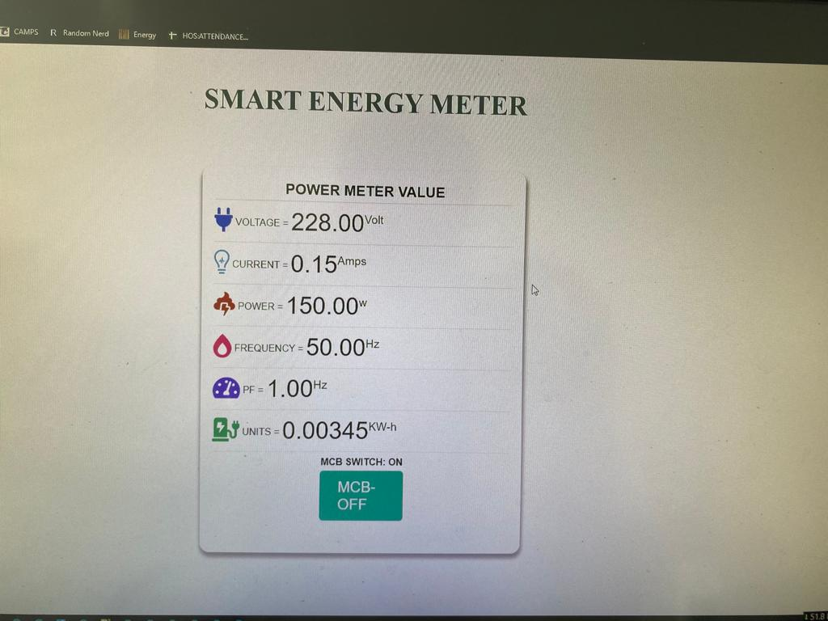
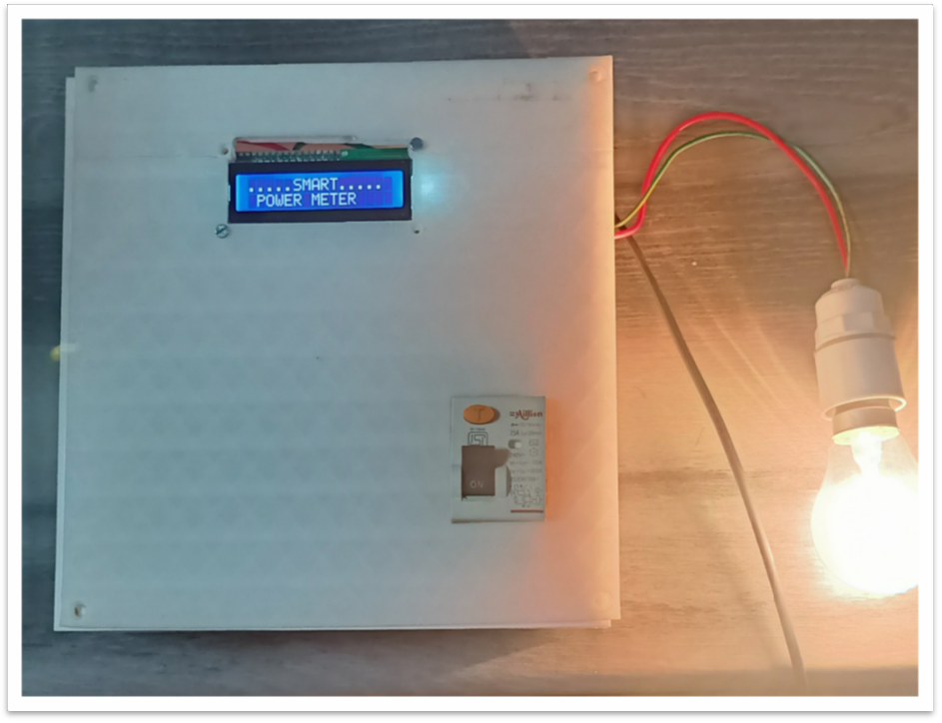
Validation / Testing / Analysis
Final product and test result:
https://www.youtube.com/watch?v=CcO0pPjPvhU

Slide 9
Cost Estimate(if required)
PZEM-004T - Rs.1090/-
2. Node Mcu - Rs. 497/-
3. Resistors - 6 x Rs.12 = 72/-
4. Electrolytic Capacitor - Rs. 50/-
5. Pin Header - Rs. 9/-
6. Female PCB Header – Rs. 65/-
7. 5V relay module - Rs. 38/-
8. 1602 I2C display - Rs. 912/-
9. PIR sensor – Rs. 125/-

Slide 10
References
Ida Bagus Gede Purwania, I Nyoman Satya Kumara, and Made Sudarma, Application of IoT-Based System for Monitoring Energy Consumption, International Journal of Engineering and Emerging Technology, Vol.5, No.2, December 2020
https://genuspower.com/everything-you-need-to-know-about-smart-electric-meters/

Slide 11

THANK YOU

